Slide 1


Exploring Optimal Machine Learning Models for Predicting Crop Yield at Township Level
Mayukha Bheemavarapu | Mehul Bhargava | Navdeep Singh Saini | Val Veeramani
June 21, 2022

Slide 2

Roadmap
1. Introduction
2. Workflow
3. Deliverables
4. Results & Findings

Slide 3

Mayukha Bheemavarapu
From Warangal, Telangana, India
Guitarist and a Bibliophile
Love travelling and hiking
Major fan of long walks!!!

Slide 4

Mehul Bhargava
From Jaipur, Rajasthan, India
Loves gardening, wildlife viewing, marker art, birding, collections, and being a phillumenist
Bachelor of Technology in Computer Science Engineering

Slide 5

Navdeep Singh Saini
New Delhi, India to Kelowna, British Columbia
Previously Technical Consultant at Adobe Systems, India
Bachelors, Computer Science Engineering, India
Loves Travelling, developed interest in cooking recently!

Slide 6

Val Veeramani
B.S. in Management Information Systems & M.S. in Business Analytics
Lived in 6 countries so far
Used to speak 5 languages at one point
Loves travelling, experiencing different cultures, and reading about psychology

Slide 7
Client – AAFC
Mission
Driving innovation and ingenuity to build a world leading agricultural and food economy for the benefit of all Canadians
Vision
Provides leadership in the growth and development of a competitive, innovative and sustainable Canadian agriculture and agri-food sector

Slide 8


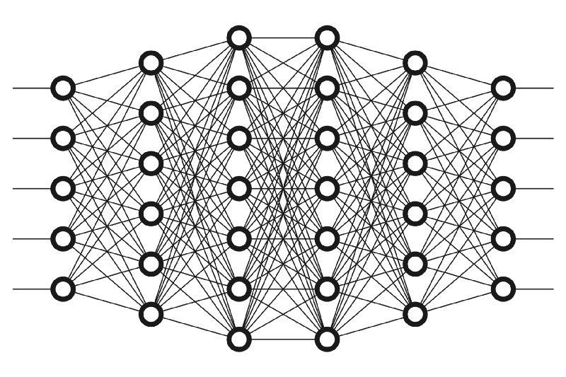



Aim & Objectives
Aim: To explore optimal machine learning models for predicting crop yield based on growing patterns, climatic and soil conditions at a township level.
Crop Yield
Crop Yield
Features
Prediction
Machine Learning
Deep Learning
Climate
Soil Moisture

Slide 9
Data Description
Crop Yield
Soil Moisture
Recorded Canola crop yield
Remote sensing data of surface soil moisture
Climate
NDVI
Recorded climatic conditions data
Indicator used to analyse the green patches on land

Slide 10
Data Wrangling
Final data set
06
Data Loading
01
Exported the final dataset as CSV
Loaded all the four data sets
05
Data Joining
Data Filtering
02
Raw Data
Merged the datasets on Year and TWP_ID
Filtered all data sets for the time range 2010-2020
Data Transformation
04
03
Data Cleaning
Calculated 3 - Week running mean
Removed/Treated missing values

Slide 11


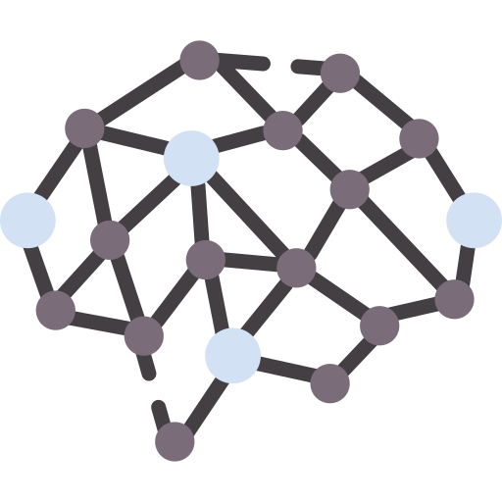
Our Approach
Problem:
Fit individual model for each Eco district (137 models)
Not our typical case of n (number of records) >> p (number of predictor variables)
Regularization Techniques
Dimensionality Reduction
Deep Learning
LASSO
Ridge Regression
PCR
PCA + Random Forest
MLP
Feed Forward NN

Slide 12
Package Functionality
Filter the required Eco District
LASSO, Ridge Regression
Validation Metrics
Feature Importance
Train the selected model
Predicted Train Yield
PCR, PCA + RF
Explained Variance (%)
Predicted Test Yield
PCR, PCA + RF
Number of Principal Components
Score the dataset

Slide 13
Feature Importance Ridge Regression

Slide 14
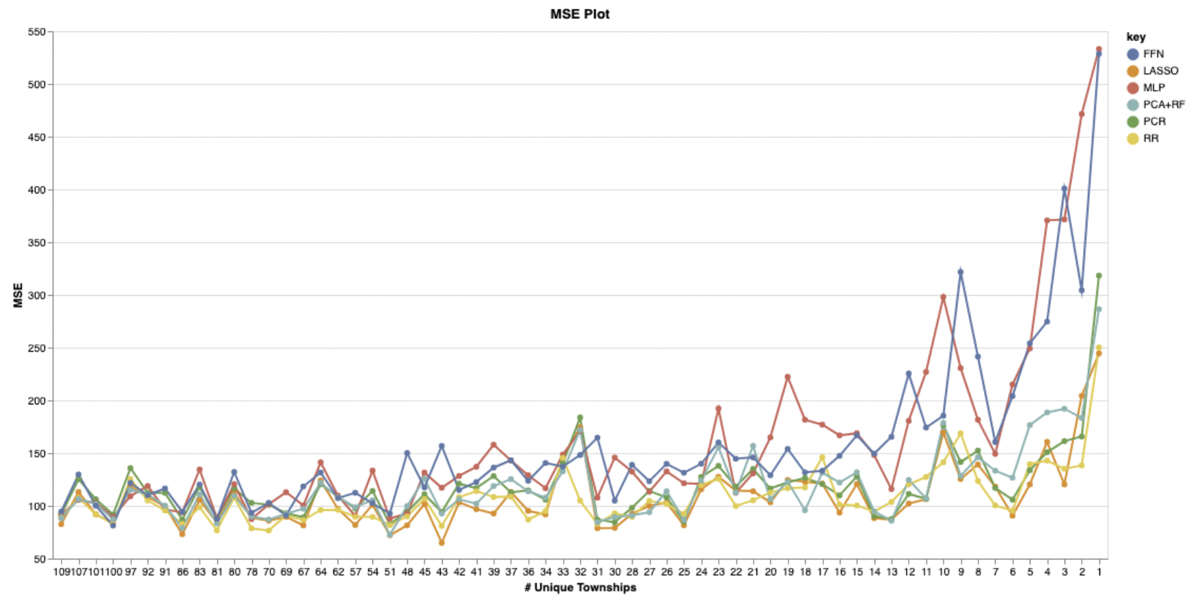
Performance – Test MSE

Slide 15
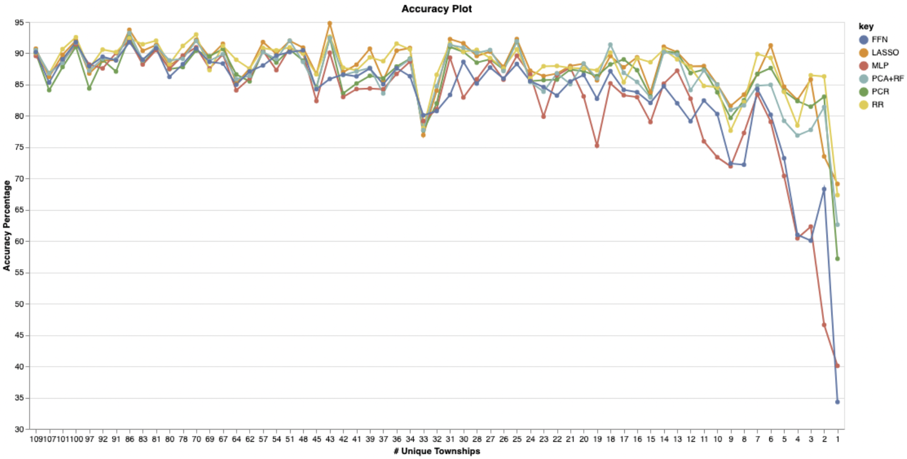
Performance – Accuracy

Slide 16
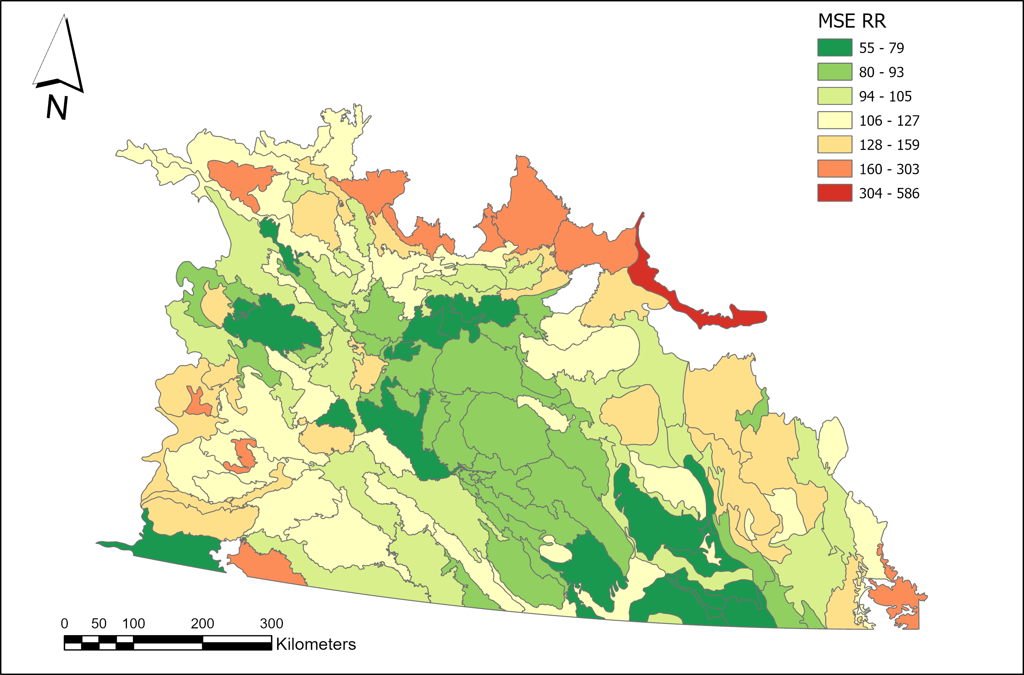
Performance – MSE Heatmap

Slide 17
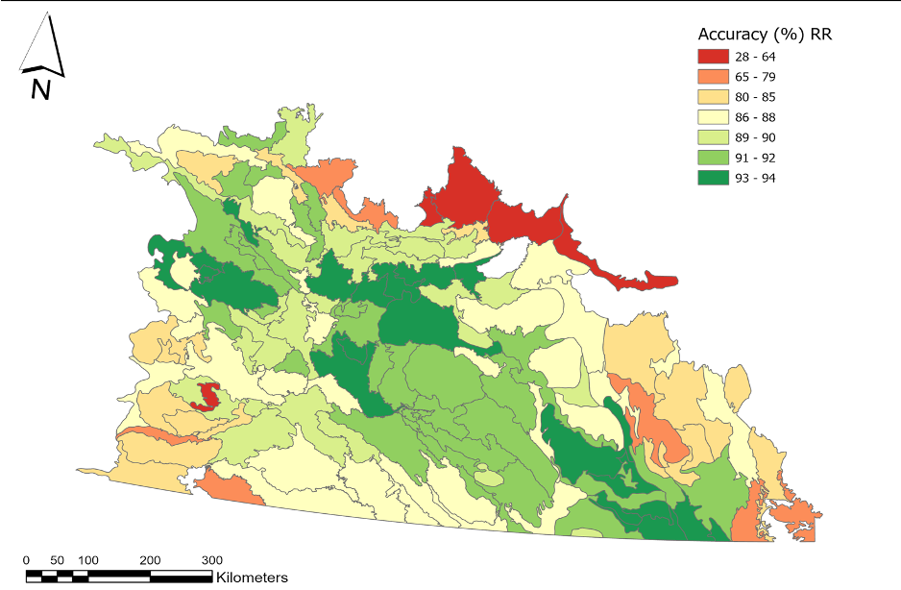
Performance – Accuracy Heatmap

Slide 18




Deliverables
Python Model Packages
Predicted Crop Yield
(Tabular form)
Model Performance Indicators

Slide 19
Results & Findings
Higher the number of townships per eco district, higher the accuracy and lower the test MSE
Zone of high accuracy of models corresponds to the zone of high density of Canola
Machine learning seem to outperform the deep learning methods when it comes to modelling with a low number of records
While it is difficult to definitively say that there is one ideal model that fits all circumstances, comparatively Ridge Regression outperforms the other models in multiple scenarios
It is in our best interest to choose a model among the six fitted models depending on the eco district in order to come up with the most accurate predicted crop yield value.

Slide 20

Questions

Slide 21

Thank You!

